Slide 1
Capstone Project1 YouTube Data Harvesting and Warehousing using SQL, MongoDB and Streamlit
By, Iswaryalakshmi

Slide 2
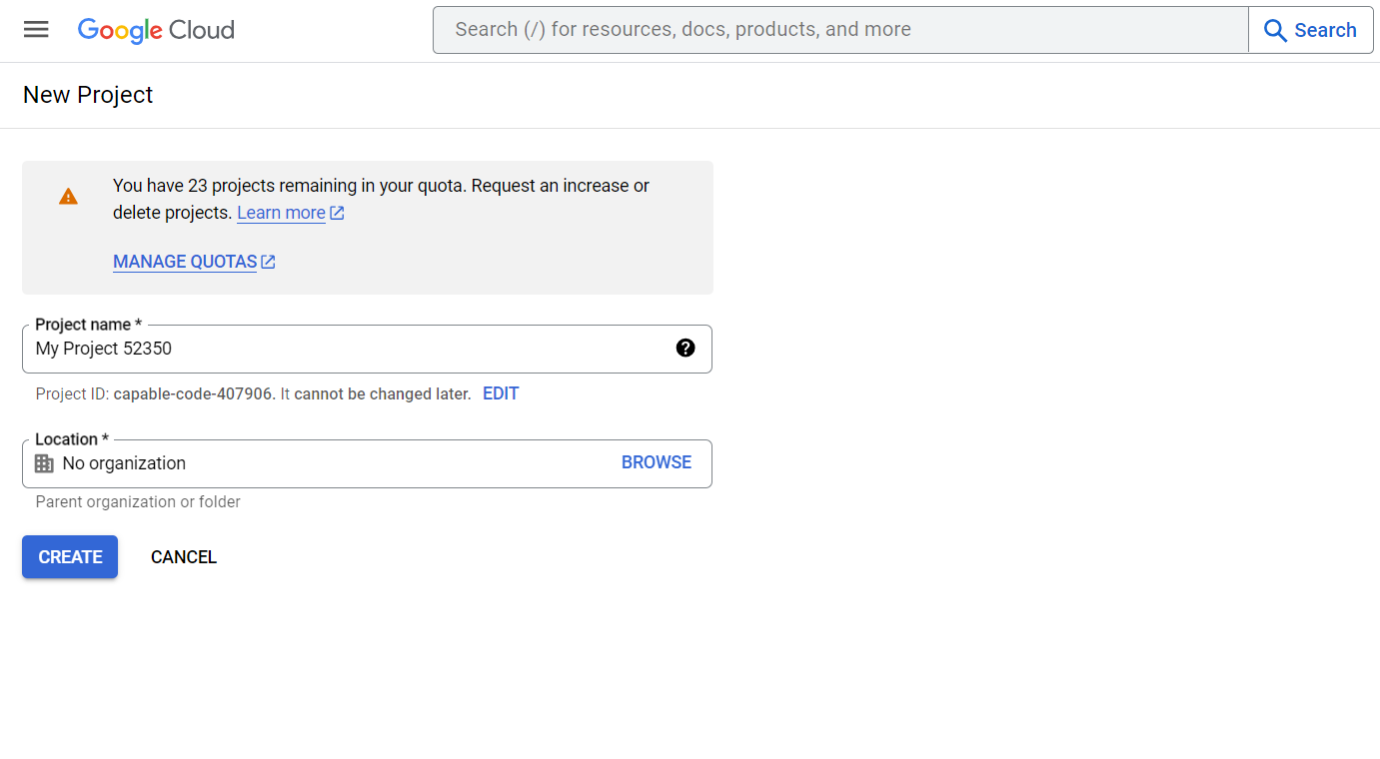
Getting YouTube API Key
Create project in Google developer console
Enable API’s
Get credentials to get YouTube API key

Slide 3
Requesting data from YouTube API
https://developers.google.com/youtube/v3/docs
Using the above link get all reference details for projects.
We can get all default functions, parameters, to add to get the needed data from YouTube API to store in MongoDB Atlas.

Slide 4
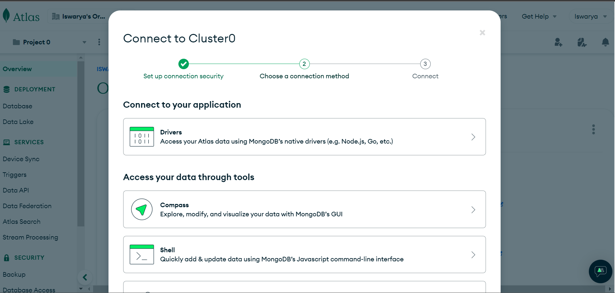
MongoDB Atlas connectivity
In web browser, open MongoDB Atlas and login using Google account or your credentials
Create project and connect through cluster
In cluster page, under drivers, get the connection strings for DB connection.

Slide 5
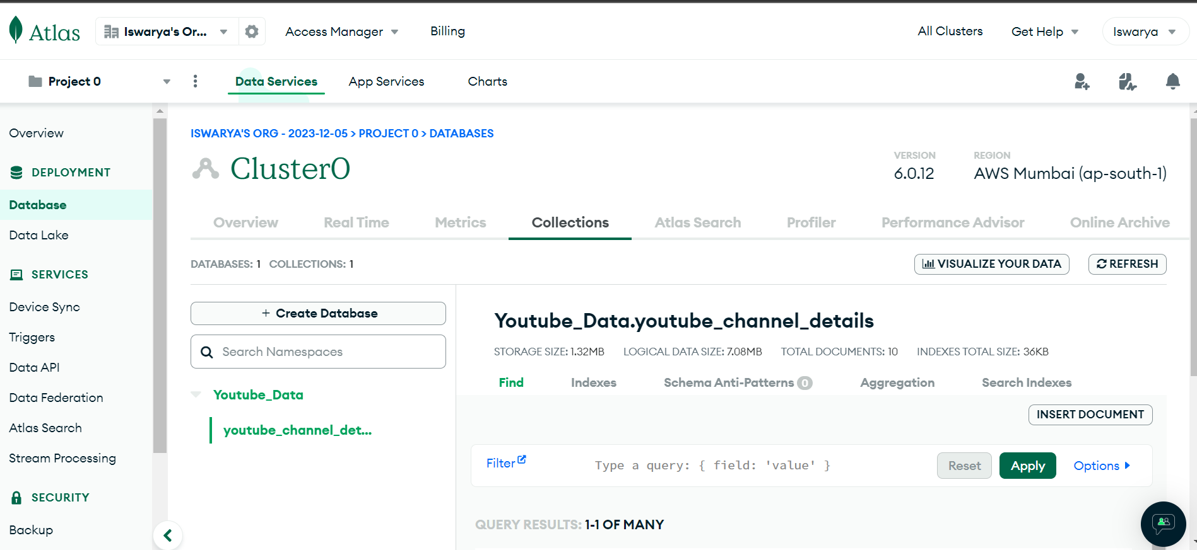
MongoDB Database and Collections

Slide 6
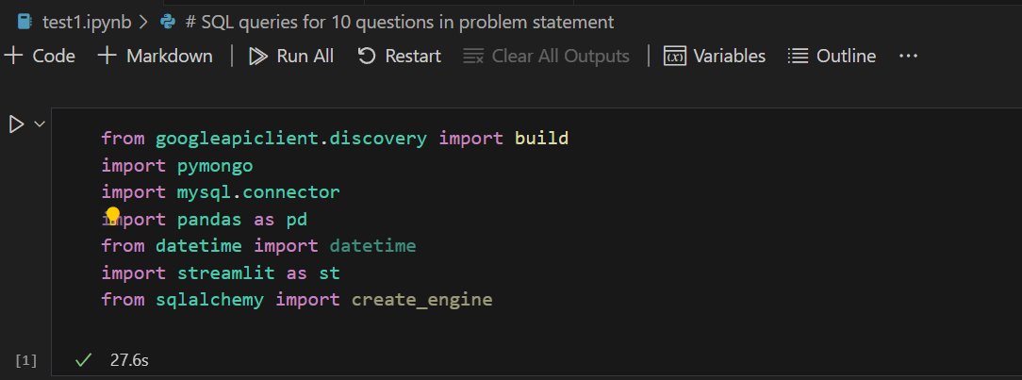
Python file
Create .py file or .ipynb file for coding perspective in VS code.
Install some packages for projects using pip install in terminal
Import below packages

Slide 7
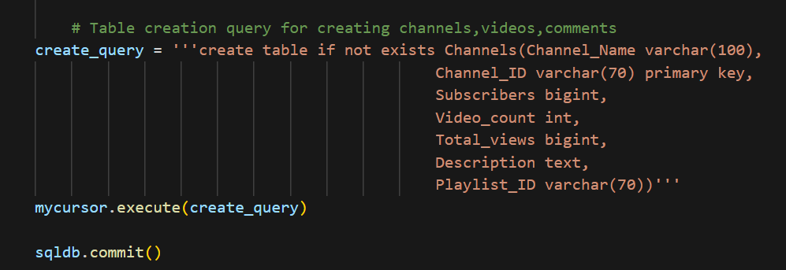
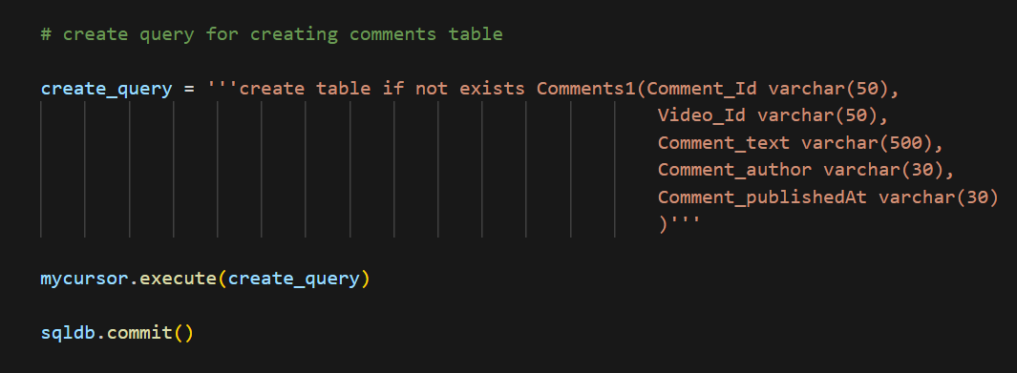
Query for creating tables using python

Slide 8
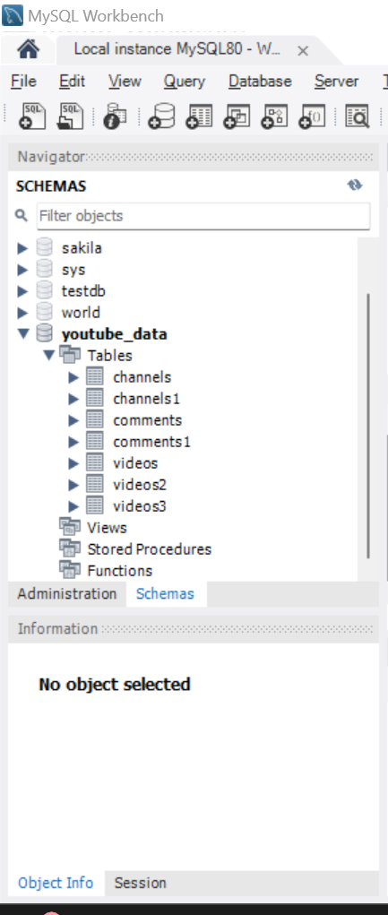
MySQL Tables
Under YouTube data database, tables like Channels, Videos, Comments are created using python.

Slide 9
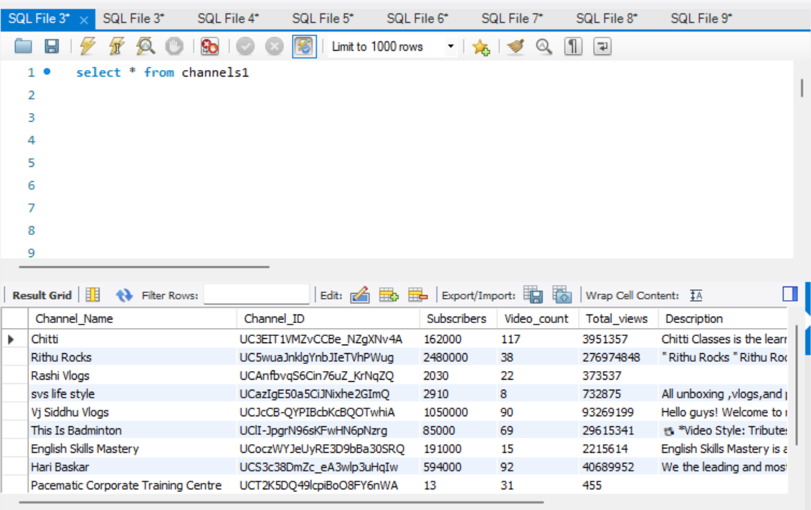
Datas are inserted in MySQL table

Slide 10
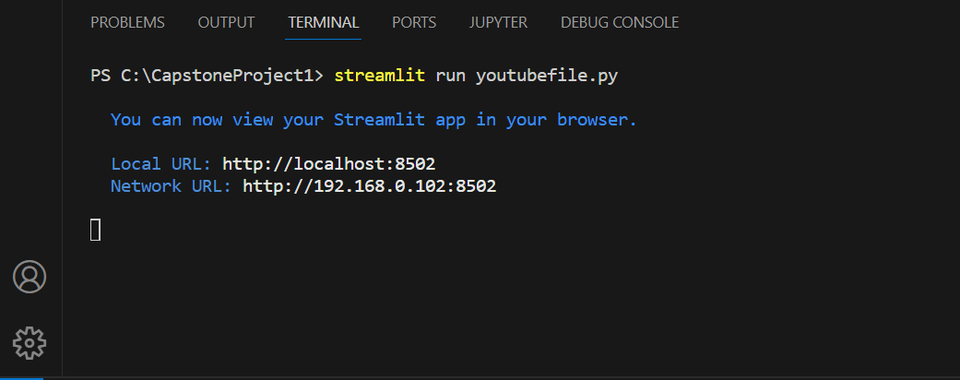
Run Streamlit in python terminal in VS code
Open terminal
Type Streamlit run yourpython.py file click enter
This will automatically open Streamlit app in localhost in your web browser.

Slide 11
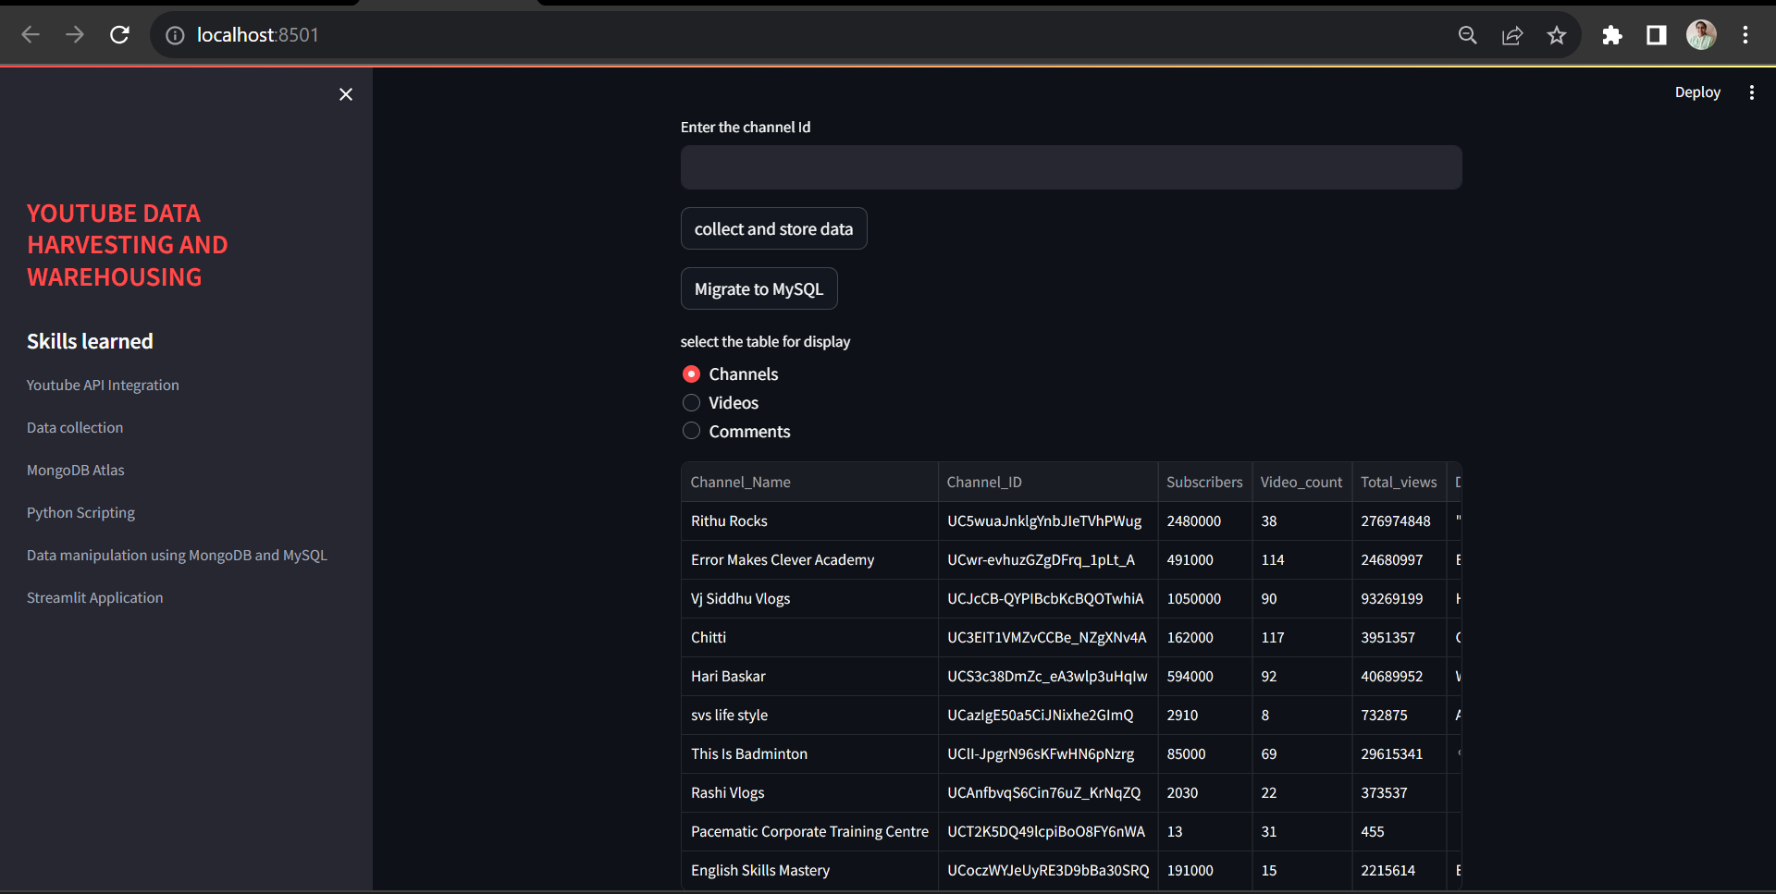
Streamlit Application output

Slide 12
Thank you!

